Slide 1

Dream
Preparatory Academy
Google Ads Campaign Overview
Group 1
Team : Mourya Gupta Vakacharla
Utkarsh Prabhakar Patil
Pratiksha Gupta
Gina Margaret D'Cunha

Slide 2

Ad Grants
Nonprofit Marketing Immersion
Post-Campaign Report

Slide 3
Table of Content
About the Organization
Audience Profile
Executive Summary
Limitations and Learnings
Past Campaign
Current Campaign
Performance Metrics Review
Goals and Social Impact
Recommended Next Steps

Slide 4
ABOUT THE ORGANISATION
Mission:
Fostering a nurturing environment that promotes independence, curiosity, and creativity in young children. The academy's mission is to empower children to become confident, compassionate, and lifelong learners.
Values:
Emphasizing individualized learning, hands-on activities
Focus on critical thinking and collaboration
Educational Approach:
STEAM-based curriculum (Science, Technology, Engineering, Arts, and Mathematics)
Designed to inspire curiosity and innovation.
Community Involvement:
Engages with the local community through events and partnerships

Slide 5

Target Audience

Slide 6
Executive Summary
What are your key takeaways or learnings from this project?
Campaign Achievements:
Improved ad quality score by 80% leading to potential increase in engagement
Slightly Increased Click Through Rate (CTR)
Key Learnings and Observations:
Using targeted keywords related to early childhood education and Montessori-based methods proved effective in reaching the right audience.
Broad match approach seemed to be more effective owing to the local nature of the organisation
Targeting wide geographical location increased the impressions obtained from local target audience as well ( Earlier - 7 impression in 20 days from Greenville In 3 days , 8 impressions from Greenville)
External factors ( Website experience / Service offerings) potentially have a substantial impact on increasing enrollment

Slide 7
Executive Summary
What are your key takeaways or learnings from this project?
Improvements & Future Directions:
Further refinement of targeting and messaging can improve conversion rates.
Testing different ad formats and placements could yield additional insights into audience preferences.
Use of data analytics to guide decision-making and strategy development will ensure sustained success.
More keywords, additional strategy tweaks
A combination of text and display ads using performance max aggregating everything in single campaign may help diversify engagement, leading to higher click-through rates (CTR).
Monitoring and adjusting bids, alongside tracking key metrics, allows for optimization of the campaign.

Slide 8
Limitations and Learnings
Enrollment Cycle
Challenges:
During off-peak periods, parents might not be actively seeking enrollment information, leading to lower conversion rates for ads.
A longer enrollment cycle could also mean a delay in achieving desired campaign results, affecting metrics like click-through rates and conversions.
Strategies to Address:
Align Google Ads campaigns with key enrollment periods to maximize response rates.
Implement a retargeting strategy to keep engagement with parents who show interest but might need more time to decide.
Use educational content to maintain interest and keep the academy top-of-mind during off-peak periods

Slide 9
Limitations and Learnings
Geographical Reach
Challenges:
Broad targeting can dilute campaign impact, leading to irrelevant impressions and reduced effectiveness.
A narrow geographical focus may limit overall reach, reducing the total number of leads and potential enrollments.
Strategies to Address:
Consider expanding reach to nearby suburbs or communities that might be willing to travel for quality education, but avoid going too broad.
Combine geographic targeting with specific keyword targeting to ensure that ads reach the right audience within the desired region.

Slide 10
Past Campaign

Slide 11
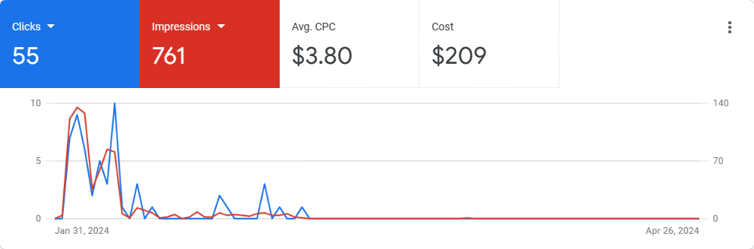
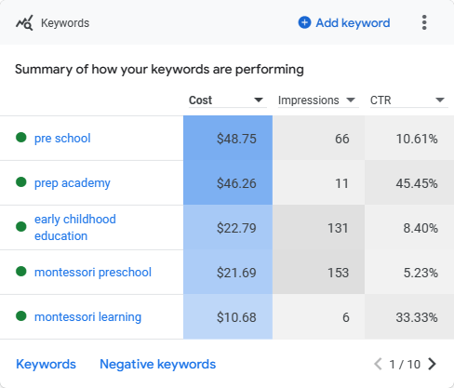
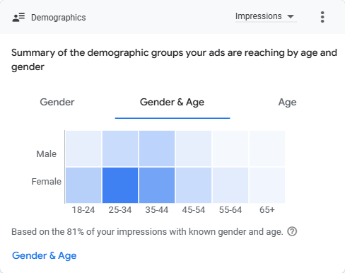
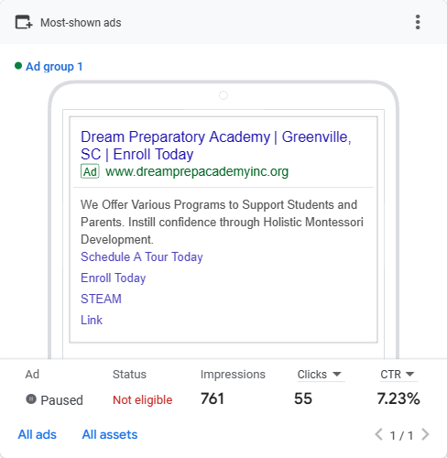
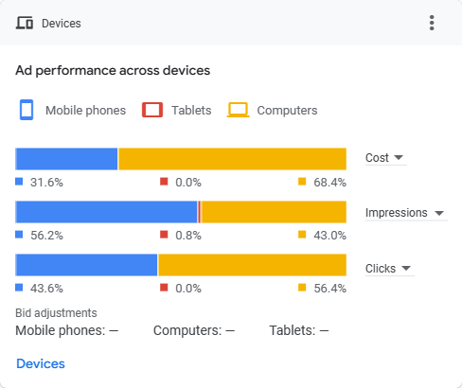

Slide 12
Diagnostics
Limited Keywords: Insufficient use of diverse and specific keywords.
Broad Match Keywords Only: Using broad match keywords without specific targeting.
Missing Custom Audience Segments: Not utilizing custom audience segments for better targeting.
Low Ad Quality Scores: Ads receive lower quality scores, affecting visibility and cost.
No Callouts or Promotions: Failing to use ad extensions like callouts, promotions, or pricing information.
Missing Business Name and Logo: Ads do not prominently feature the business name or logo, impacting brand recognition.
Notes:
Higher impressions in January, gradually reduced to 0 in March

Slide 13
New Campaign: 04/02/2024

Slide 14
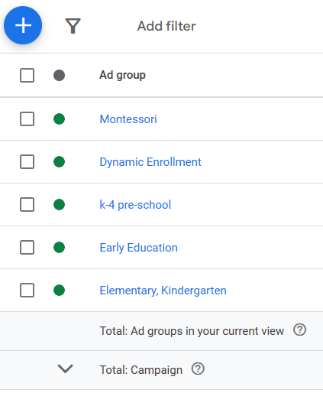
Ad groups

Slide 15
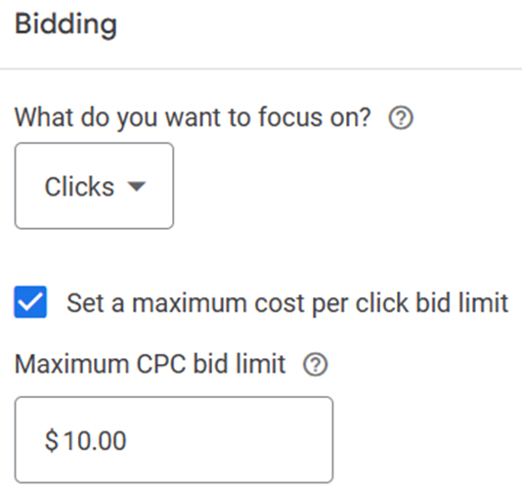
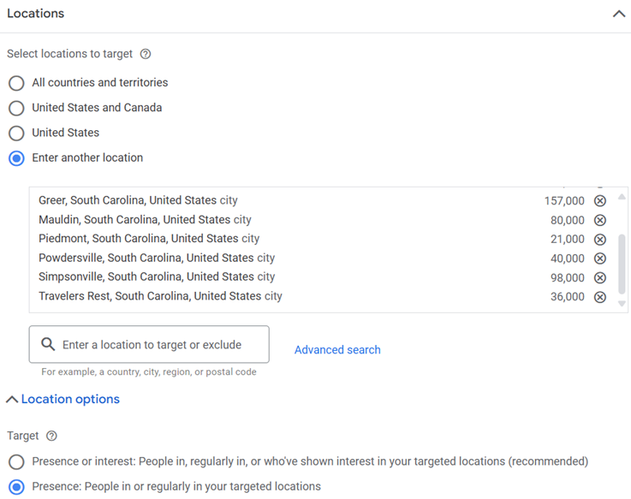
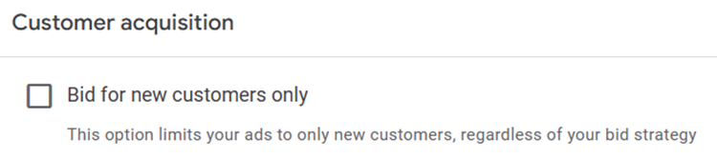
Notes:
This limit is crucial because it helps control your advertising costs and ensures that you don't spend more than your budget allows. However, it's important to note that setting a high max CPC doesn't guarantee that you'll pay that amount for every click. Google Ads operates on an auction system, where advertisers bid for ad placement, and the actual amount you pay per click (known as the actual CPC) can be lower than your max CPC.
So, focusing on clicks with a max CPC limit of $10 means you're aiming to get clicks on your ads while not exceeding $10 per click. This strategy involves finding a balance between bidding high enough to compete effectively for ad placement but not overspending on individual clicks.

Slide 16
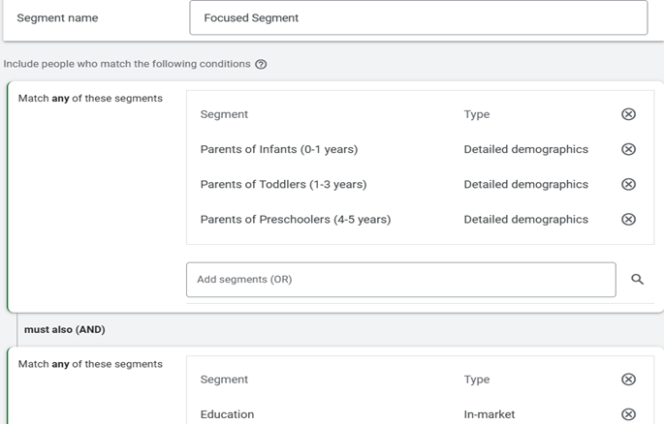
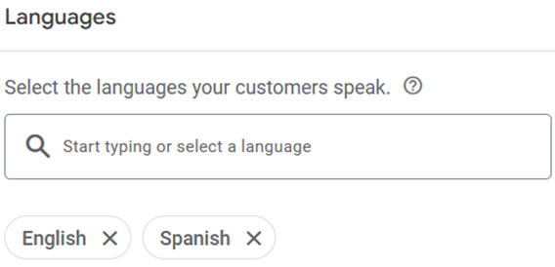
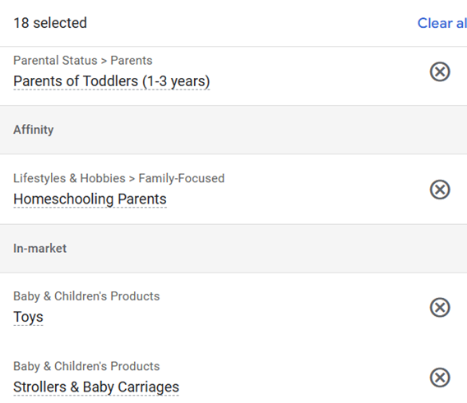
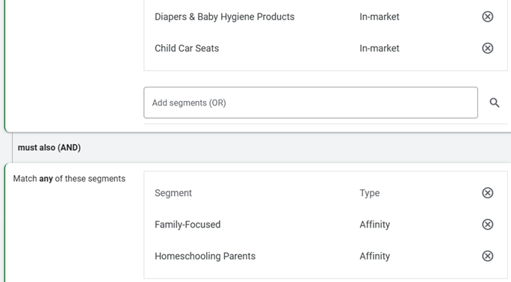
Notes:
In Google Ads, "Affinity Audiences" and "In-Market Audiences" are two types of audience targeting options that advertisers can use to reach specific groups of users based on their interests, behaviors, and purchase intent.
1. **Affinity Audiences**: These are broad audience categories that reflect users' long-term interests and passions. Google categorizes users into affinity audiences based on their online behavior, such as the types of websites they visit, the content they consume, and their search history. Affinity audiences are ideal for brand awareness campaigns and reaching users who are likely to have a general interest in your products or services.
2. **In-Market Audiences**: In contrast to affinity audiences, in-market audiences consist of users who are actively researching or showing purchase intent for specific products or services. Google identifies these users based on their recent search behavior, browsing activity, and other online signals indicating a strong intention to make a purchase in a particular category. In-market audiences are valuable for advertisers looking to target users who are closer to making a purchase decision and are more likely to convert.
By using affinity and in-market audiences in their Google Ads campaigns, advertisers can better target their ads to users who are most likely to be interested in their offerings, whether they're building brand awareness or driving conversions. These audience targeting options help advertisers optimize their ad spend by reaching users who are more likely to engage with their ads and take desired actions.

Slide 17
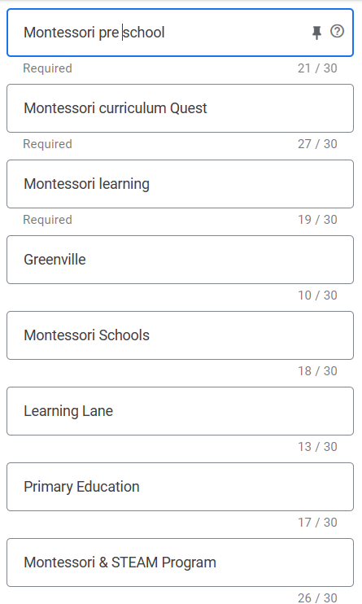
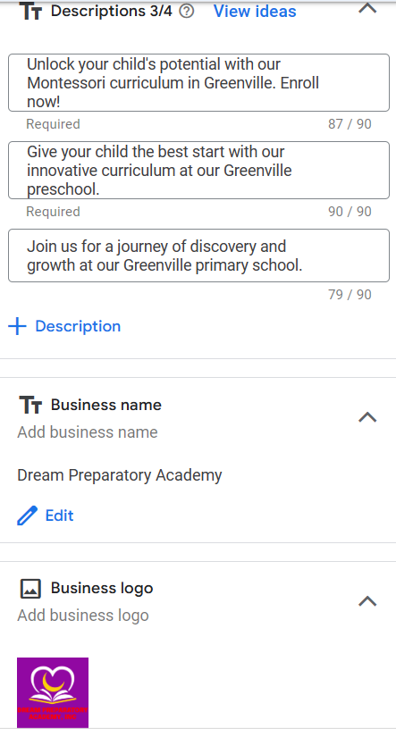
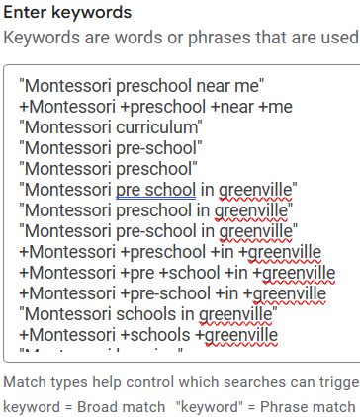
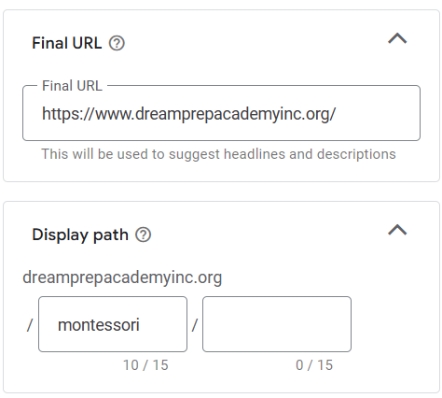

Slide 18
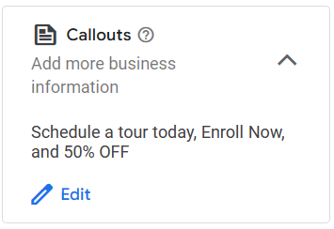
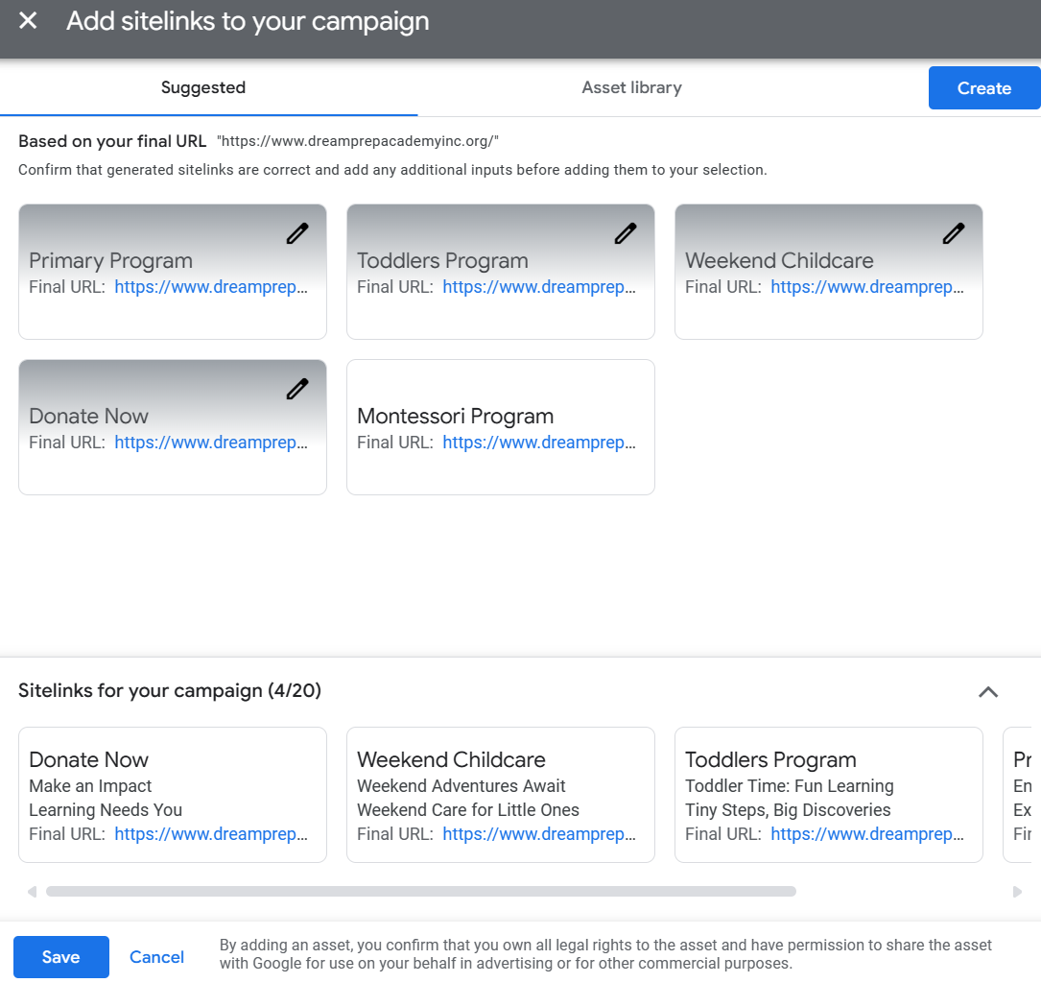
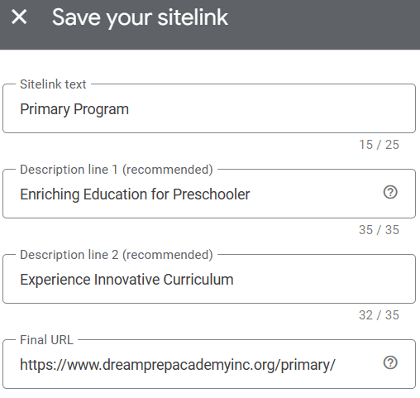
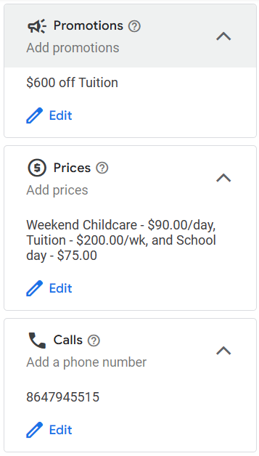

Slide 19
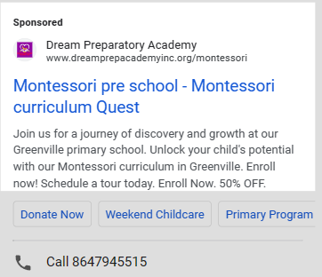
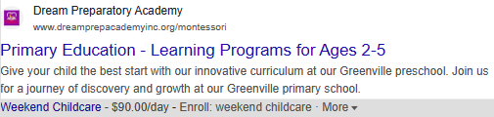
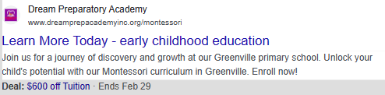
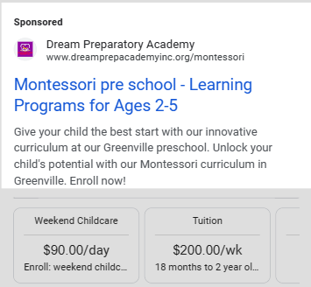
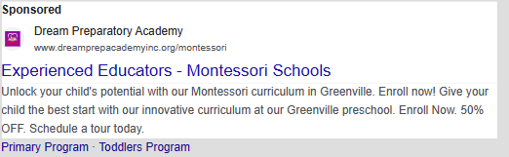

Slide 20
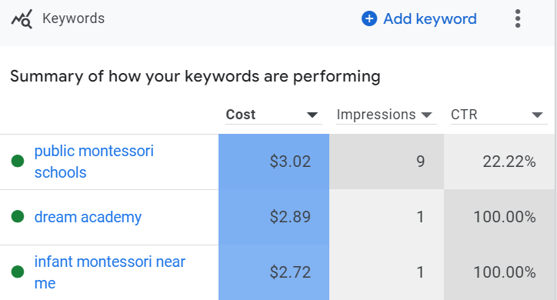
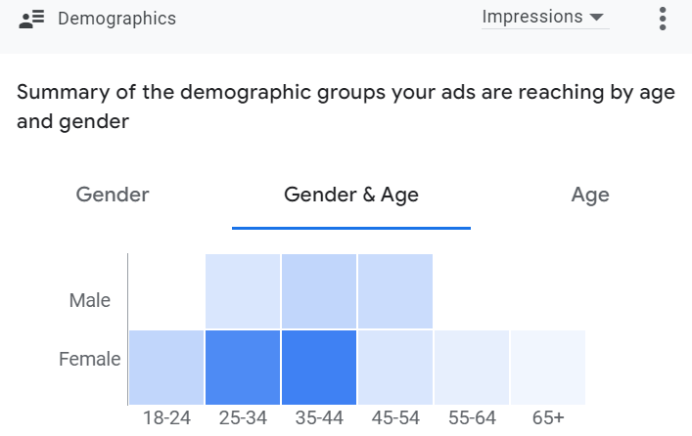
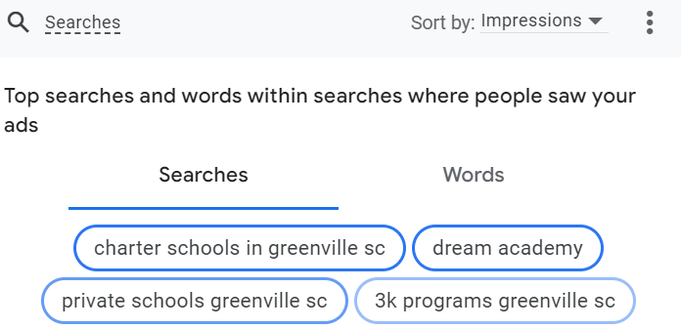
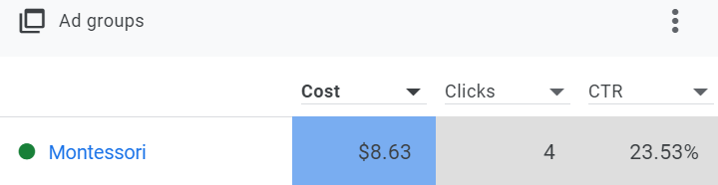
Top Performing Keywords
Demographics
Top Searches
Top Ad Group

Slide 21
Previous Campaign
Present Campaign
Use of only Broad match keywords
Less number of keywords
Lack of custom audience segments
Below par Ad quality scores
No usage of callouts, promotions, prices, calls
No Business name, logo
Added Phrase and Exact match keywords
Added more than 200 keywords
Added custom audience segment for very narrow selection for conversions
Better quality ads
Included callouts, promotions, prices and calls
Included Business name and logo

Slide 22
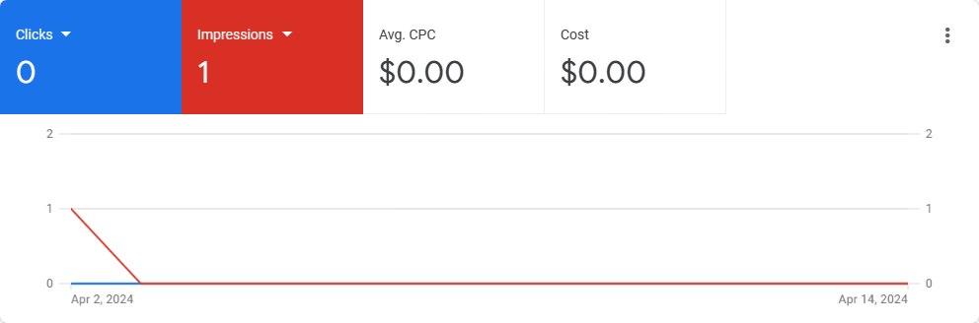
Campaign performance from 04/02 to 04/14
Learning Stage with only 1 impression

Slide 23
Campaign Modification: 04/15/2024

Slide 24
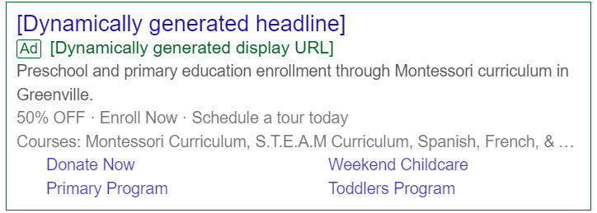
Initial Stage of Campaign
Campaign after modification
Added 600+ keywords
Removed redundant keywords
Dynamic Ad Search
1 impression
Notes:
Dynamic Search Ads (DSAs) in Google Ads are a type of ad format that automatically generates headlines and landing pages based on the content of your website. Instead of using keywords to target specific search queries, DSAs use Google's organic web crawling technology to match users' search queries with relevant content on your website.
Here's how Dynamic Search Ads typically work:
1. **Website Crawling**: Google's web crawling technology regularly indexes the content of your website to understand its structure, organization, and the products or services you offer.
2. **Dynamic Ad Creation**: When a user enters a search query that's relevant to your website's content but doesn't precisely match your existing keywords, Google dynamically generates an ad headline and landing page URL based on the content of your website. The ad headline is dynamically generated to closely match the user's search query.
3. **Targeting and Bidding**: Advertisers can set specific targeting parameters for their Dynamic Search Ads, such as targeting specific pages or categories on their website. Bidding strategies can also be adjusted to prioritize certain types of traffic or to optimize for specific goals, such as clicks or conversions.
4. **Ad Customization**: While the headlines and landing page URLs are dynamically generated, advertisers still have control over other aspects of the ad, such as ad descriptions and ad extensions. This allows advertisers to add additional messaging or calls to action to the dynamically generated ads.
Dynamic Search Ads are particularly useful for advertisers with large or constantly changing inventories, as they can help ensure that their ads remain relevant to users' search queries without the need to constantly update keyword lists. They can also be effective for capturing additional traffic from long-tail search queries or for targeting users searching for specific products or services that may not be covered by existing keyword campaigns.

Slide 25
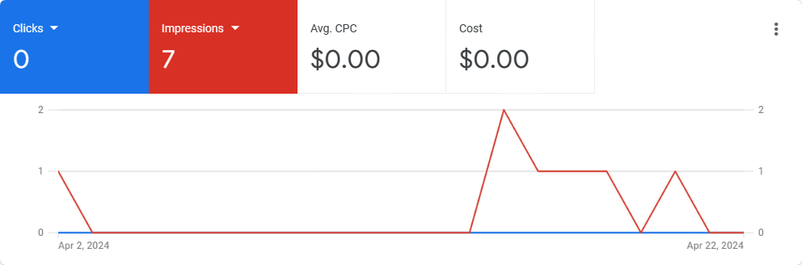
Campaign performance from 04/02 to 04/22
Less impressions probably because of very specific location​
No utilization of budget

Slide 26
Campaign Modification: 04/22/2024 Current Campaign

Slide 27
Previous Campaign
Present Campaign
Less impressions probably because of very specific location
No utilization of budget
Changed Greenville county to entire United states
Improved in clicks and impressions

Slide 28
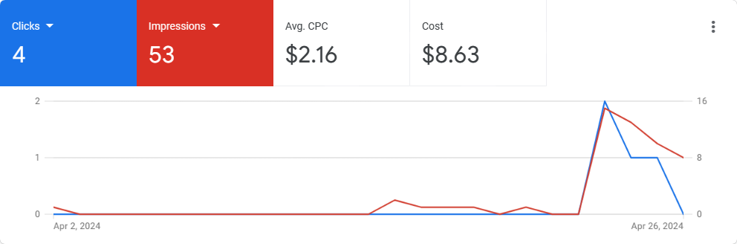
Campaign performance from 04/02 to 04/26

Slide 29
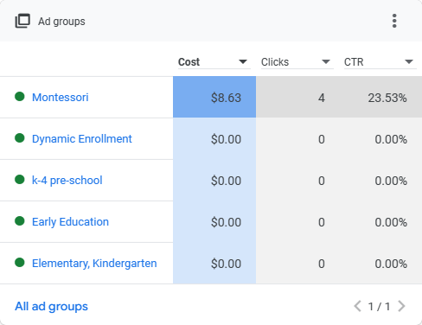
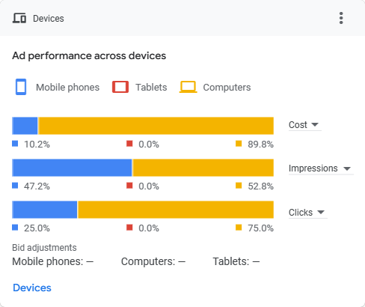
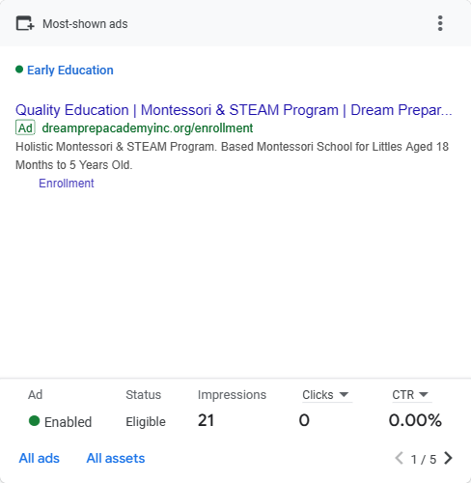
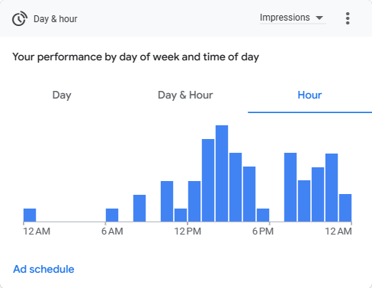
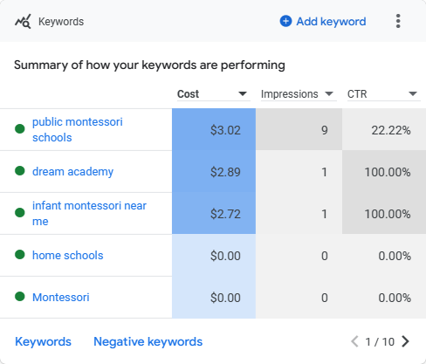
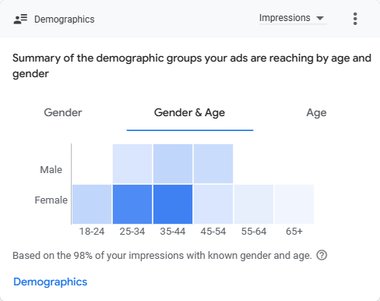

Slide 30
Performance Metrics Review
Goal
Pre 04/01/2024
Post 04/26/2024
Pre/Post Change Rate %
Goal Achieved? (Yes/No)
Clicks/Week
CTR %
Ad Quality Score
Total Spend
Optimization Score
>30 | 6.8 | 2 | -70% | No
7.24% | 7.24% | 7.55% | 0.31% | Yes
10 | 4-5 | 8 | 78% | No
$300 | $3 | $4.3 | 43% | No
100% | 72% | 87.9% | 22% | No

Slide 31
Marketing Goals Review
Long term goal – Will need more time to drive enrolment
Increase Enrolment

Slide 32
Marketing Goal Achievement & Social Impact
1 Explain how your Ad Grants campaigns had an impact in supporting the nonprofit’s mission.
2 How did you design your campaigns to meet the nonprofit’s goals?
3
Dream Prep had zero impressions since March 06. Our Campaign has started getting impressions again.
More Keywords, More Ad Groups, Better Ad quality
What would you advise the nonprofit to change in the future to better accomplish their digital marketing goals?
Addition of backlinks, Nonfunctioning Calls to action, more tweaks in the campaign

Slide 33
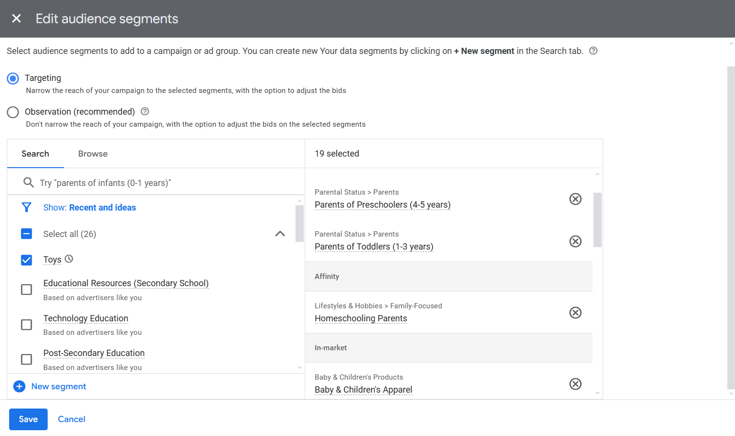
Recommended Next Steps
The audience segments can be set to Observation instead of Targeting.
We have an option to bid for the targeted segments also

Slide 34
Recommended Next Steps
Additional Keywords:
Keywords from past campaign: High impressions
Pre School
Pre School near me
Early Learning Academy
Preschool Curriculum
Greenville
Preschool Activities
Montessori School

Slide 35
Thank You

Slide 36
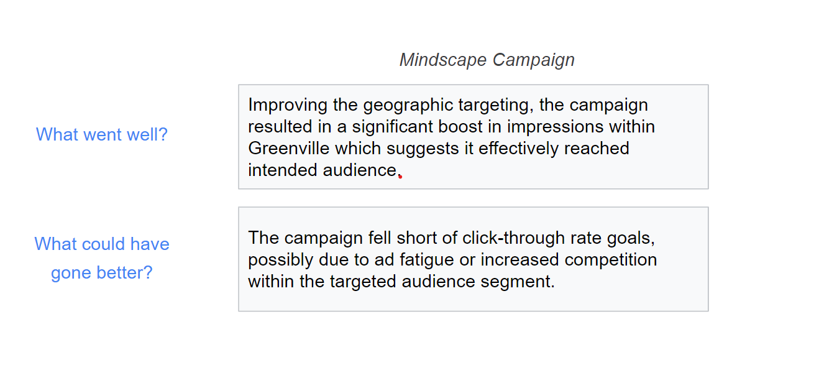
Campaign Recap & Analysis

Slide 37

Webpage recommendation based on SEO analysis
Non-functional call to action

Slide 38
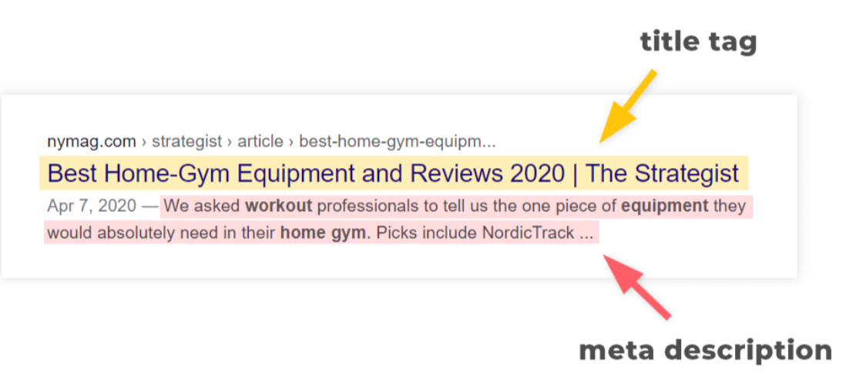
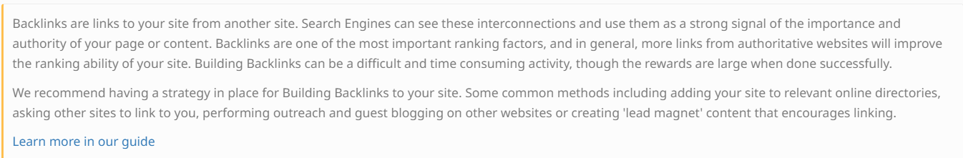
Webpage recommendation based on SEO analysis
Meta Description tag missing
Backlinks missing

